Slide 1
MENTAL HEALTH DETECTOR AN AI-POWERED TOOL FOR DETECTION AND TREATMENT OF MENTAL HEALTH DISORDERS
BY GROUP 2

Slide 2
BUSINESS UNDERSTANDING; PROBLEM STATEMENT
BACKGROUND
Mental health significantly impacts daily life, yet many people—especially in low- and middle-income regions—face barriers to care, including stigma and lack of access. With over 1 in 8 people globally affected by mental health disorders, there is a pressing need for early and accessible support. AI can help fill this gap by detecting emotional distress through text, offering supportive feedback, and encouraging self-reflection. These tools not only aid individuals but also assist therapists by tracking emotional trends and enhancing patient care, making AI a valuable partner in mental health support.
PROBLEM STATEMENT
Many people struggle with mental health issues but face barriers like cost, stigma, and limited access to therapists. Emotional distress often goes unaddressed, and even those in care lack tools for tracking emotions between sessions. There’s a growing need for accessible, private tools that support self-reflection and provide valuable insights to therapists.

Slide 3
PROJECT DESCRIPTION; OBJECTIVES
Categorize emotional expression into broad mental health categories using historical input data.
Analysis-based objectives
Analyze user-generated text to uncover emotional and linguistic patterns associated with mental health conditions such as anxiety, depression, and burnout.
Identify trends and frequencies of symptoms that may signal the onset or escalation of mental health challenges.
Categorize emotional expression into broad mental health categories using historical input data.
Categorize emotional expression into broad mental health categories using historical input data.
Feature engineering objectives
Preprocess textual data through tokenization, lemmatization, and removal of stop words to ensure clean input for model training.
Extract relevant features such as:
Emotional tone (positive, negative, neutral)
Symptom-related keywords and phrases
Frequency and persistence of emotional states
Time-aware features for tracking changes over time

Slide 4
PROJECT DESCRIPTION; OBJECTIVES
3. Modeling Objectives
Develop and fine-tune a multi-label NLP model that can detect multiple co-occurring mental health conditions from text input.
Integrate the model into an interactive chatbot system designed to:
Deliver empathetic, condition-aware responses
Encourage users to perform daily emotional check-ins or journaling
Provide coping strategies and motivational content
Assess distress levels (mild, moderate, severe) to tailor response tone and urgency
Evaluate model performance using relevant multi-label metrics including Hamming Loss, Subset Accuracy, and F1-score.

Slide 5
PROJECT DESCRIPTION; DATA DESCRIPTION
Mental Health Content (mentalhealth.org.uk):
Signs, symptoms, and emotional indicators
Self-care and professional help recommendations
Used to train emotional tone detection and generate supportive chatbot responses
Demographic and behavioral data:
Features: age, gender, occupation, stress levels, physical activity
Includes user input and mental health condition labels
Used to train the multi-label classification model

Slide 6
DATA PREPARATION
s
Mental health content
Focused on descriptive mental health content: Signs, symptoms, coping strategies, and recommendations
No missing values
Processed using SentenceBERT to generate embeddings for classification and chatbot response modeling
Demographic and behavioral data
Included structured features like: Age, gender, occupation, diet quality, smoking habit, alcohol consumption, sleep hours, physical activity hours, stress level, social media usage, consultation history, medication usage, work hours.
Missing values in severity column handled using mode imputation
Used to train the CatBoost model for multi-label classification and risk prediction

Slide 7
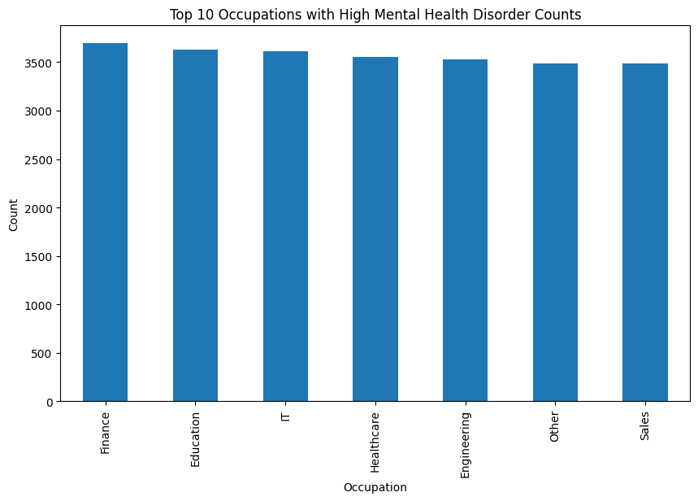
EXPLANATORY DATA ANALYSYS
Before continuing to modeling we tried some EDA to try uncover patterns in the data. And we found;
Majority of users are aged between 20 and 35, showing mental health engagement is stronger among young adults.
Gender distribution is fairly balanced across the dataset.
High stress levels are commonly reported, indicating it's a key factor for mental health issues.
Occupation-wise, mental health disorder counts are highest in fields like Finance, Education, IT, and Healthcare, suggesting certain professions may be more affected by work-related mental strain.

Slide 8
MODELLING
Text-based modeling
Used SentenceBERT to convert user input (symptoms, journal entries) into semantic embeddings
Trained a multi-label classifier to detect conditions like depression, anxiety, and burnout
Integrated into a chatbot that responds empathetically and offers condition-specific suggestions
Structured data modeling
Used a CatBoost Classifier trained on 13 behavioral and demographic feature
Target: Multi-label classification of conditions + severity prediction (mild, moderate, severe)
Handled missing values using mode imputation (severity column)

Slide 9
MODEL INTERPRETABILITY AND EVALUATION
Text-based model (sentenceBERT + multi-label classifier)
Goal: Detect mental health conditions (e.g., anxiety, depression, burnout) from symptom descriptions
Evaluation Metrics:
Hamming Loss: 0.14
Subset Accuracy: 76%
Macro F1-score: 0.81
Structured data model (CatBoostClassifier)
Goal: Predict mental health conditions & severity from lifestyle features
Evaluation metrics:
Accuracy: 83%
Marco F1-score: 0.78
Weighted f1-score: 0.82

Slide 10
SYSTEM DESIGN
Platform: Streamlit web app
Modes :
Signs-Based – NLP-powered prediction from user-described symptoms
Lifestyle-Based – Structured data prediction from age, stress, sleep, etc.
Model Architecture
model_nlp.pkl
SentenceTransformer for symptom encoding
Pre-embedded disorder vectors
Recommendation DataFrame (self-care, professional, other)
Model_structured.pkl
Risk prediction model (binary classifier)
Severity level model (multi-class classifier)
Label encoders for categorical inputs

Slide 11
SYSTEM DESIGN
Prediction flow
Signs-based flow
User inputs text description of symptoms
Text is embedded using SentenceTransformer
Compared against disorder embeddings using cosine similarity
Top 3 disorders shown, with one identified as top concern
Recommendations retrieved from data base based on predicted disorder
Lifestyle-based flow
User fills in demographic + lifestyle inputs (age, sleep, stress, etc.)
Inputs are encoded using pre-trained encoders
Passed into a risk classifier → outputs Low Risk or High Risk
If High Risk, severity is predicted (e.g., mild, moderate, severe)

Slide 12
CONCLUSION
The Mental Health Prediction Assistant is a dual-approach system designed for early detection and support in mental health by combining NLP-based symptom analysis with structured lifestyle data.
It enables personalized predictions, scalable mental health screening, and tailored recommendations for users.
Built with a modular and interpretable architecture, the system is user-friendly and adaptable for real-world use in digital health platforms, awareness campaigns, or personal self-assessment tools.
Overall, it serves as a step toward bridging the gap between early signs of mental distress and timely intervention.

Slide 13
THANK YOU. ANY QUESTIONS?

